Slide 1
Modified Search

Slide 2
~$9Mil monthly Opportunity Lost
Marginal revenue forfeiture resulting from low returning customer ratio
Notes:
40% new customers
7% returning conversion rate vs 0.7%
~400k

Slide 3
OUR PROCESS IS EASY
Customers get frustrated with search experience and go to Amazon.com
Provide more relevant search results by creating AI solution that translates user input into product database language
The result is a product search experience that reduces

Slide 5
Basically, have to get to the product punch right away
Maybe 1-2 slides outlining the problem and solution
Currently, product search returns very weak solution
Products are not relevant at all to the needs of the customer
We have created a relevance engine that uses keyword data to provide much more relevant result
Then, show what happened when you did it the old way
Then, what happens when you do it the new way
Show the backend… ”this data is XX% more relevant, producing XX more clicks and an XX increase in revenue
Thank you

Slide 6
We are going to have it working on the backend, but it will not be connected to the UI
We will show a simulation through webpage mockups. Then when they want us to display it working, we will bring up the r engine and show it with another search term…
“here look, when we do it on the web page it is these bad results... When we run it in our engine, these will be the top results... Much better

Slide 9
How
Two AI engines
1) Tagging engine: Engine assigns descriptors to user accounts, based on direct + indirect input
2) Relevance engine: Engine ranks products by relevance and delivers top results, based on direct + indirect input

Slide 10
USE CHARTS TO EXPLAIN YOUR IDEAS
Tag
Relate

Slide 12
INSTRUCTIONS FOR USE
Open this document in Google Slides (if you are at slidescarnival.com use the button below this presentation)
You have to be signed in to your Google account
EDIT IN GOOGLE SLIDES
Go to the File menu and select Make a copy.
You will get a copy of this document on your Google Drive and will be able to edit, add or delete slides.
EDIT IN POWERPOINT®
Go to the File menu and select Download as Microsoft PowerPoint. You will get a .pptx file that you can edit in PowerPoint.
Remember to download and install the fonts used in this presentation (you’ll find the links to the font files needed in the Presentation design slide)
More info on how to use this template at www.slidescarnival.com/help-use-presentation-template
This template is free to use under Creative Commons Attribution license. If you use the graphic assets (photos, icons and typographies) provided with this presentation you must keep the Credits slide.

Slide 13
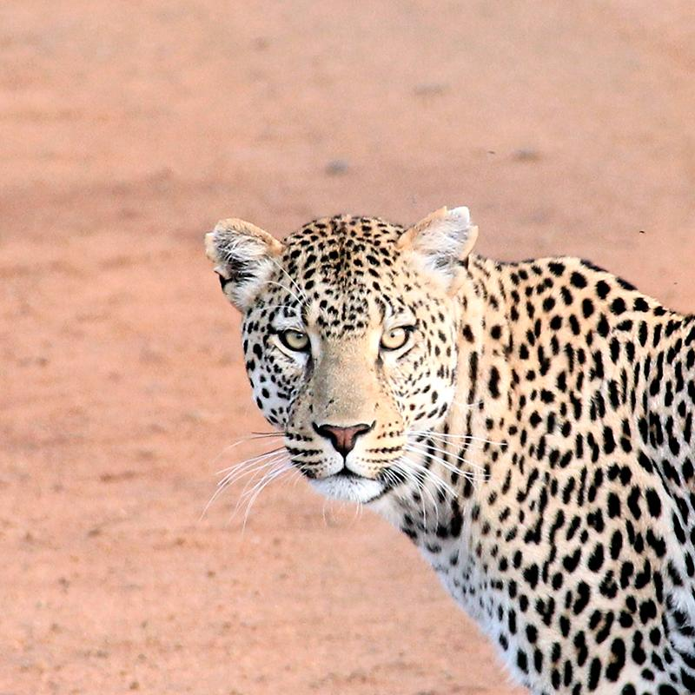
Hello!
I AM JAYDEN SMITH
I am here because I love to give presentations.
You can find me at @username

Slide 14
TRANSITION HEADLINE
1
Let’s start with the first set of slides

Slide 15
Quotations are commonly printed as a means of inspiration and to invoke philosophical thoughts from the reader.

Slide 16
THIS IS A SLIDE TITLE
Here you have:
A list of items
And some text
But remember not to overload your slides with content
You audience will listen to you or read the content, but won’t do both.

Slide 17
BIG CONCEPT
Bring the attention of your audience over a key concept using icons or illustrations

Slide 18
YOU CAN ALSO SPLIT YOUR CONTENT
White
Is the color of milk and fresh snow, the color produced by the combination of all the colors of the visible spectrum.
Black
Is the color of coal, ebony, and of outer space. It is the darkest color, the result of the absence of or complete absorption of light.

Slide 19
IN TWO OR THREE COLUMNS
Yellow
Is the color of gold, butter and ripe lemons. In the spectrum of visible light, yellow is found between green and orange.
Blue
Is the colour of the clear sky and the deep sea. It is located between violet and green on the optical spectrum.
Red
Is the color of blood, and because of this it has historically been associated with sacrifice, danger and courage.

Slide 20
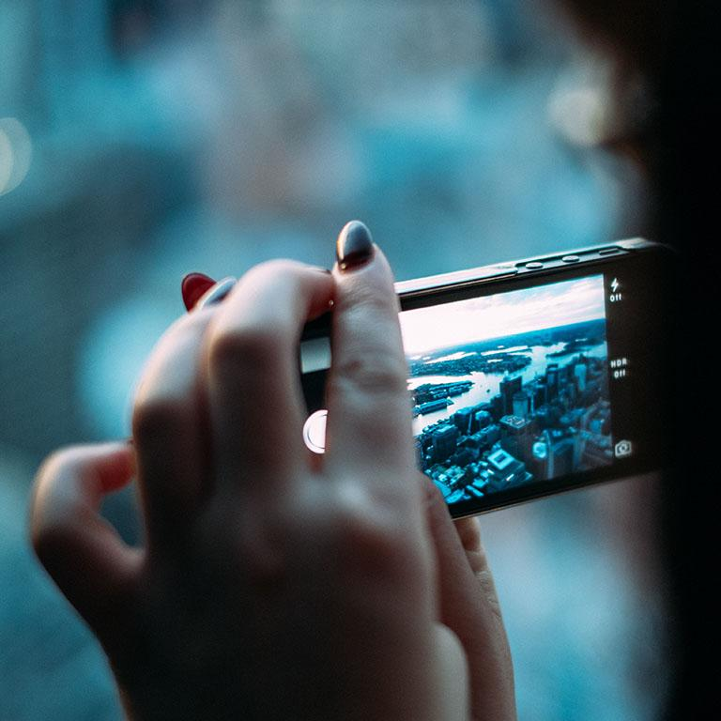
A PICTURE IS WORTH A THOUSAND WORDS
A complex idea can be conveyed with just a single still image, namely making it possible to absorb large amounts of data quickly.

Slide 21
WANT BIG IMPACT?
Use big image.

Slide 22
USE CHARTS TO EXPLAIN YOUR IDEAS
White
Gray
Black

Slide 23
AND TABLES TO COMPARE DATA
 | A | B | C
Yellow | 10 | 20 | 7
Blue | 30 | 15 | 10
Orange | 5 | 24 | 16

Slide 24

MAPS
our office

Slide 25
89,526,124
Whoa! That’s a big number, aren’t you proud?

Slide 26
89,526,124$
185,244 users
100%
That’s a lot of money
And a lot of users
Total success!

Slide 27
OUR PROCESS IS EASY
First
Second
Last

Slide 28
LET’S REVIEW SOME CONCEPTS
Yellow
Is the color of gold, butter and ripe lemons. In the spectrum of visible light, yellow is found between green and orange.
Blue
Is the colour of the clear sky and the deep sea. It is located between violet and green on the optical spectrum.
Red
Is the color of blood, and because of this it has historically been associated with sacrifice, danger and courage.
Yellow
Is the color of gold, butter and ripe lemons. In the spectrum of visible light, yellow is found between green and orange.
Blue
Is the colour of the clear sky and the deep sea. It is located between violet and green on the optical spectrum.
Red
Is the color of blood, and because of this it has historically been associated with sacrifice, danger and courage.

Slide 29
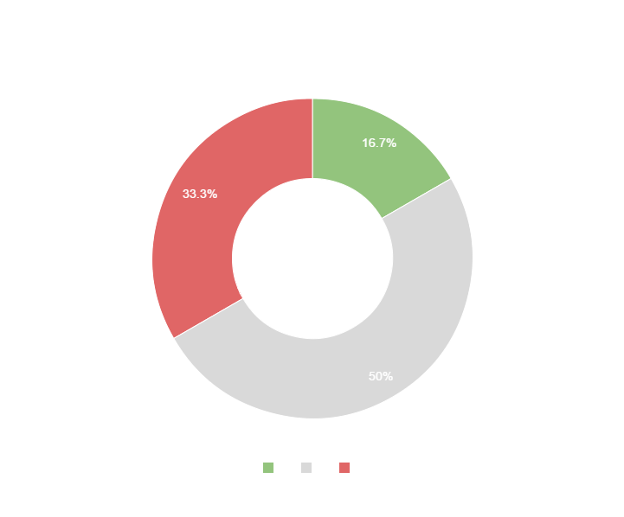
You can copy&paste graphs from Google Sheets

Slide 30
Place your screenshot here
ANDROID PROJECT
Show and explain your web, app or software projects using these gadget templates.

Slide 31
Place your screenshot here
iPHONE PROJECT
Show and explain your web, app or software projects using these gadget templates.

Slide 32
Place your screenshot here
TABLET PROJECT
Show and explain your web, app or software projects using these gadget templates.

Slide 33
Place your screenshot here
DESKTOP PROJECT
Show and explain your web, app or software projects using these gadget templates.

Slide 34
Thanks!
ANY QUESTIONS?
You can find me at
@username
user@mail.me

Slide 35
CREDITS
Special thanks to all the people who made and released these awesome resources for free:
Presentation template by SlidesCarnival
Photographs by Unsplash

Slide 36

PRESENTATION DESIGN
This presentations uses the following typographies and colors:
Titles & body copy: Quicksand
You can download the fonts on this page:
http://www.google.com/fonts#UsePlace:use/Collection:Quicksand:300,400,700
Click on the “arrow button” that appears on the top right
Dark gray #2e3037
Aqua #39c0ba
Salmon #f35b69
Blue #6d9eeb
You don’t need to keep this slide in your presentation. It’s only here to serve you as a design guide if you need to create new slides or download the fonts to edit the presentation in PowerPoint®

Slide 37
SlidesCarnival icons are editable shapes.
This means that you can:
Resize them without losing quality.
Change line color, width and style.
Isn’t that nice? :)
Examples:

